Slide 1
Machine learning based clinical decision support for antimicrobial stewardship
William Bolton
CAMO UK Data AI Meeting
21st June 2022
Notes:
Welcome everyone
My name is Will Bolton
Today I’m going to be presenting my PhD early stage assessment as part of the AI4Health CDT programme

Slide 2





Machine learning can support optimised antibiotic decision making.
INTRODUCTION
IV TO PO
MULTI-MORBIDITY
FAIR & USEFUL AI
STAGES OF ANTIBIOTIC DECISION MAKING
A
B
1
Infection or not
C
2
Empiric treatment
Antimicrobial resistance (AMR) is a global threat. One key strategy to tackle this is to undertake stewardship and optimise antimicrobial use
Clinical decision support systems (CDSSs) utilising machine learning (ML) have been developed to assist with managing infections
3
Narrow therapy
Cessation
IV to oral switch
Readmission
Side effects
4
Duration
Notes:
Bacterial AMR resulted in an estimated 1.27 million deaths in 2019
prolong current antimicrobials therapeutic life
trained on historical patient data
Unfortunately, the uptake and utilisation of such systems has been limited to date, in part due to integration and behavioral issues
Ultimately our work will focus on what could actually influence clinical decision making in the real world. This means considering a number of different influences and ultimately trying to can change a clinician's behaviour when making decisions.

Slide 3




Fair interpretable machine learning for individualised IV to oral switch decision making.
INTRODUCTION
IV TO PO
MULTI-MORBIDITY
FAIR & USEFUL AI
CLINICAL GUIDELINES AND REAL-WORLD DATA
INTERPRETABLE DECISION SUPPORT
MIMIC
n=8,694
eICU
n=1,668
Short feature set
n=5
Metric | 1st threshold | 2nd threshold
AUROC | 0.78 (SD 0.02) | 0.69 (SD 0.03)
Accuracy | 0.76 (SD 0.01) | 0.83 (SD 0.01)
TPR | 0.80 (SD 0.05) | 0.48 (SD 0.06)
FPR | 0.25 (SD 0.02) | 0.10 (SD 0.02)
Notes:
IV-Oral Antibiotic Switch Therapy (IVOST) Guideline
Canonical Time-series Characteristics (catch22)
IVOST parameters:
Blood pressure
GCS
Heart rate
O2 sat
Respiratory rate
Temperature
93 features with SHAP value ≥ 0.5
SMOTE

Slide 4
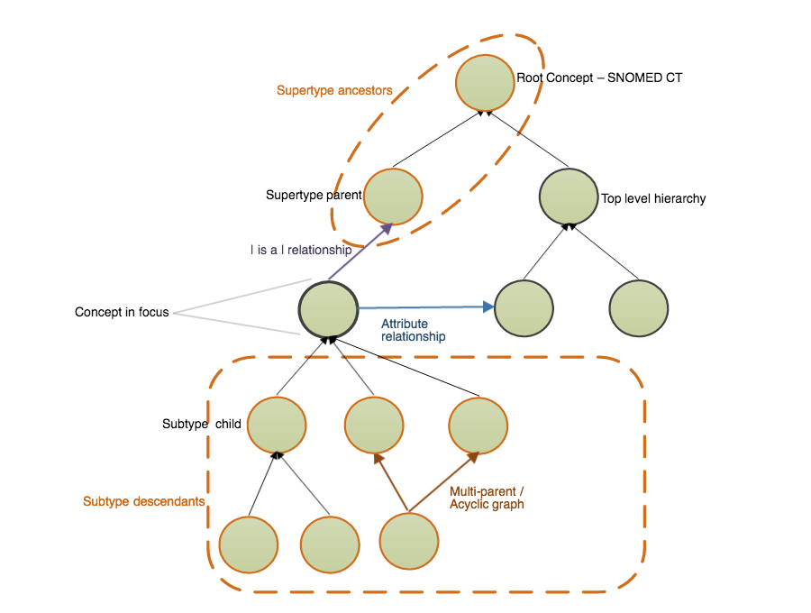

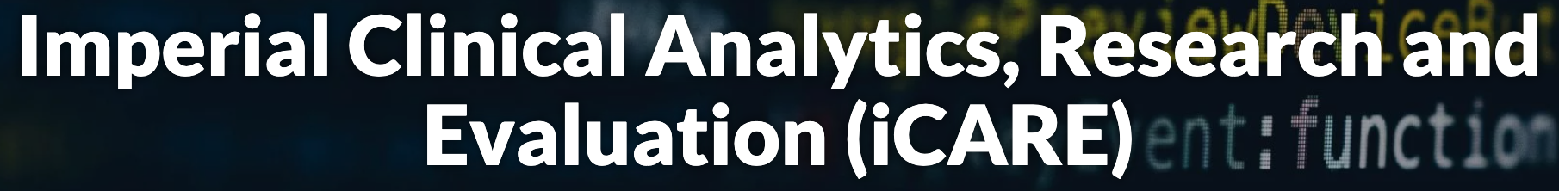
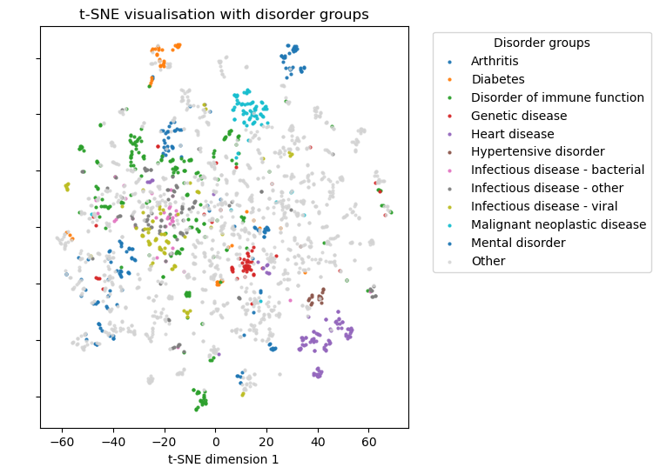
Tapping into unused clinical knowledge for multi-morbidity in machine learning.
INTRODUCTION
IV TO PO
MULTI-MORBIDITY
FAIR & USEFUL AI
SNOMED EMBEDDINGS
SIMILAR PATIENT RETRIEVAL TASK
 | SNOMED embeddings | Rocheteau method | One hot encodings
SNOMED similarity score | 1.78 | 3.52 | 4.40
D1
‘is a’
D2
Notes:
IV-Oral Antibiotic Switch Therapy (IVOST) Guideline
Canonical Time-series Characteristics (catch22)
IVOST parameters:
Blood pressure
GCS
Heart rate
O2 sat
Respiratory rate
Temperature
93 features with SHAP value ≥ 0.5
SMOTE

Slide 5

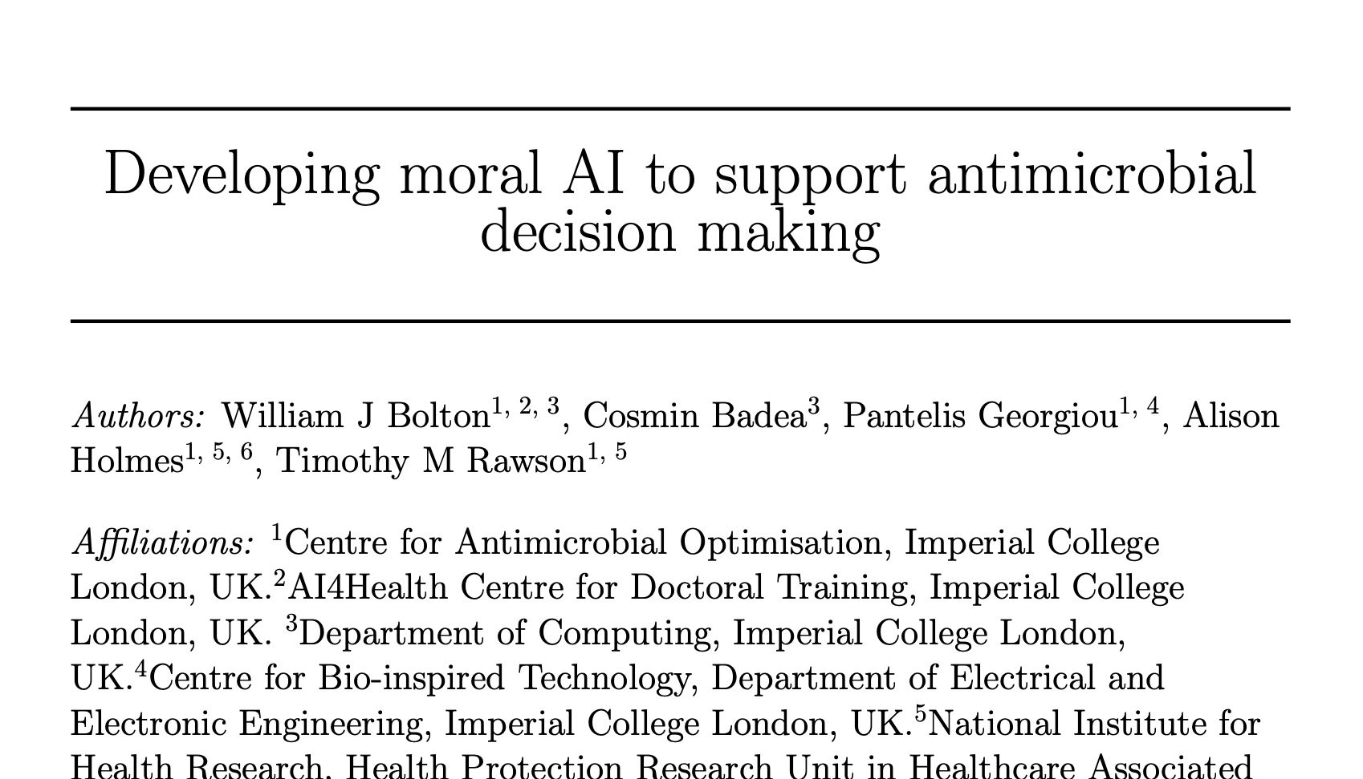
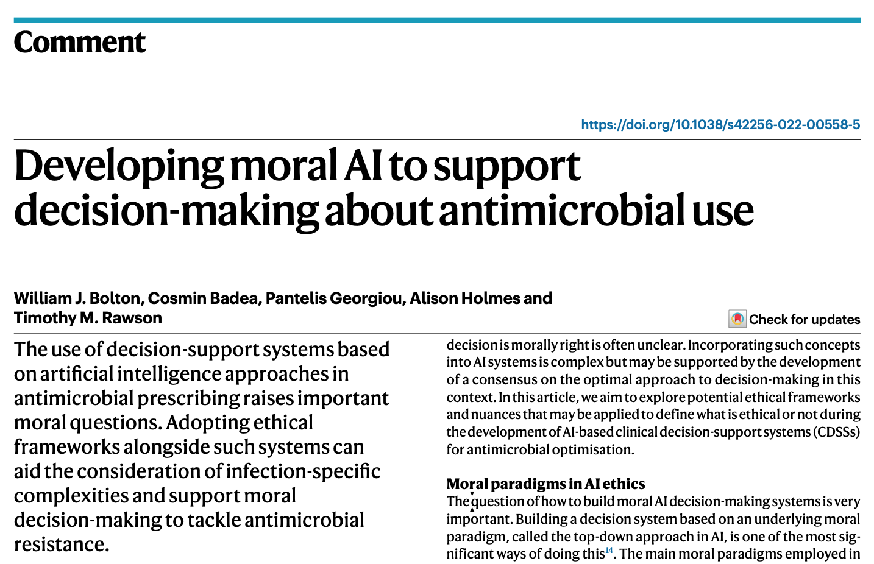

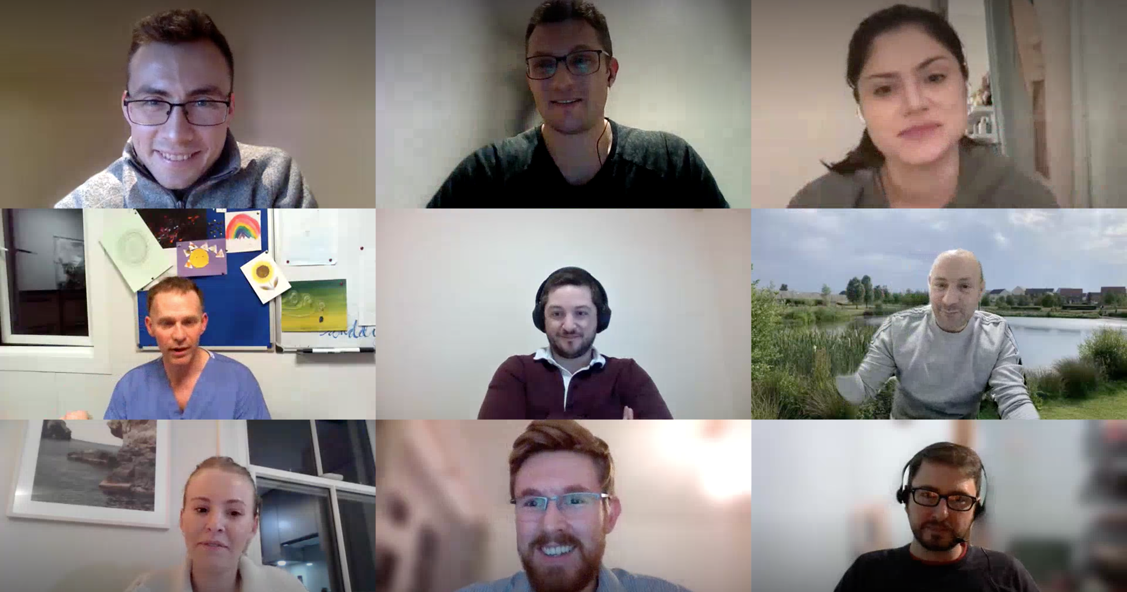
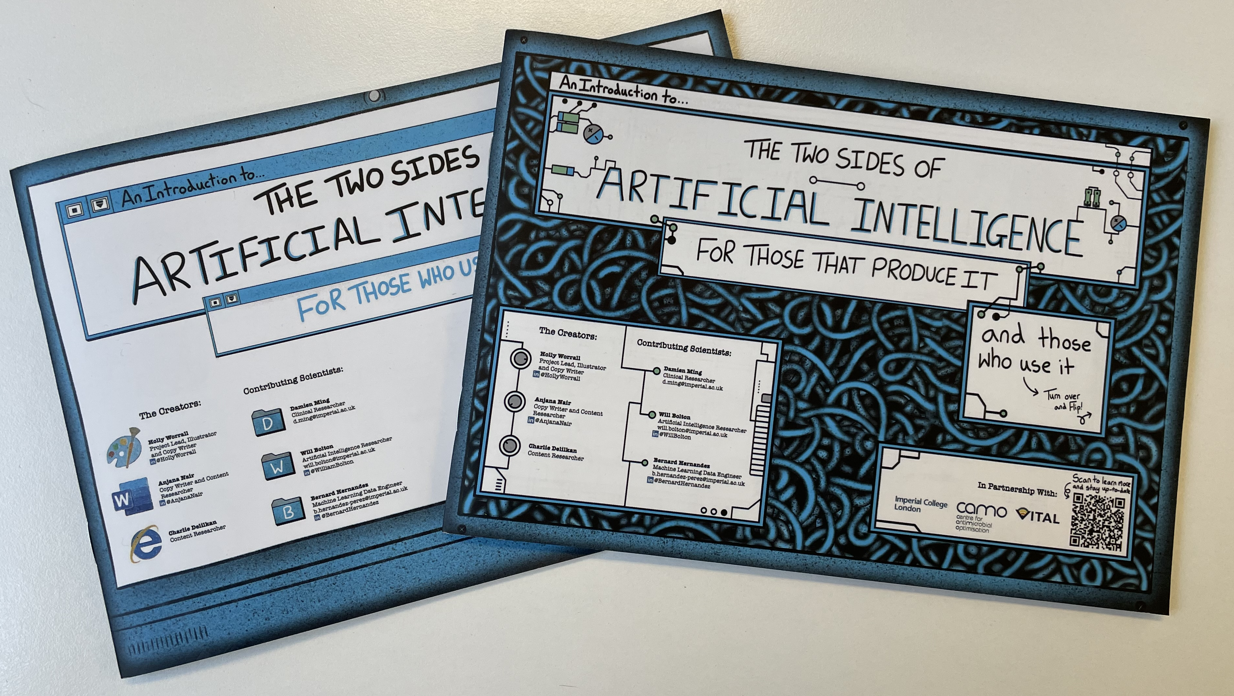
Patient, public and stakeholder views as well as ethical theories have been considered to ensure solutions are fair.
INTRODUCTION
IV TO PO
MULTI-MORBIDITY
FAIR & USEFUL AI
ETHICAL VIEWPOINT
PRIMARY RESEARCH

Slide 6
I would like to acknowledge the contribution of the following individuals.
Dr Tim Rawson
Professor Pantelis Georgiou
Professor Alison Holmes
Mr Richard Wilson
Dr Bernard Hernandez Perez
Dr David Antcliffe
Dr Damien Ming
Dr Esmita Charani
Notes:
I would like to thank these individuals for their input to this work and the UKRI and CDT for the funding

Slide 7
Thank you!
William Bolton
CAMO UK Data AI Meeting
21st June 2022
Notes:
Welcome everyone
My name is Will Bolton
Today I’m going to be presenting my PhD early stage assessment as part of the AI4Health CDT programme

